Slide 1


Perfomance Optimization of EE Architecture For Software Define Vehicles
AY 2021-2025
GITAM UNIVERSITY
Major Project
Project ID: Alpha 7 & V15
A University should be a place of light, of liberty, and of learning.
Department of Electrical Electronics and Communication Engineering
Project Team:
Sunkara Venkatesh
Poluru Sai Chaithanya
Gurram Chethan Sree Royal
Project Mentor:
Dr. S. Karthick
www.gitamedu.com

Slide 2




Project Group – Details
Photo
Track
Roll No
Name
Photo
ECE
BU21EECE0100308
Sunkara Venkatesh
Photo
ECE
BU21EECE0100208
Poluru Sai Chaithanya
Photo
ECE
BU21EECE0100529
Gurram Chethan Sree Royal

Slide 3
Objective and Goals
Objective
Performance measurement of FIELD PROGRAMMABLE GATE ARRAY.
To implement communication protocols I2C, SPI and controller area network (CAN) protocols using FPGA design.
To compare the communication protocols and measure its performance.
To design the verilog analysis in the communication protocol.
Design and Implementation: To design and implement the CAN, I2C, and SPI communication protocols in Verilog, ensuring each protocol meets industry standards for data transfer, signal integrity, and timing.
Simulation and Validation: To simulate the functionality of each protocol and validate their performance through waveform analysis, ensuring reliable data transmission, real-time communication, and error detection.
Goals

Slide 4
Project plan -Gantt Chart
Milestone #2
Literature survey
Kick Off
August 30
Milestone #4
Making report and PPT
Sign Off
July 22
Milestone #1
Abstract –Aug 8
Review
Milestone #3
Project implementation
Final review
2018
July
August
August
Aug
Sep
Sep
Oct
oct
2019
2024
8 days
Preparatory Phase
70%
Jul 22 - Aug 30
Today
24 days
Phase 1 Work Effort
70%
34 days
Phase 2 Work Effort
85%
23 days
Phase 3 Work Effort
90%
35 days
31 days

Slide 5
Literature Survey
S.NO | Title of paper | year | Authors | Key findings | Drawbacks
1. | Module Implementation and Simulation of Timing Constraint Check Function of I2C Protocol Using Verilog | 2023 | Jun-Cheol Lee; Tae-Oh Kim; Joo-Hyung Chae | methodology of Verilog modeling to check the compliance of the various timing parameters of the I2C-bus specification. | The research on implementing and simulating the I2C protocol's timing constraint check function in Verilog has several drawbacks. Simulations may not fully capture real-world conditions like signal noise or hardware limitations.
2. | Implementation Of I2C Protocol With Adaptive Baud Rate Using Verilog | April 2024 | Naveen RS; Sanjay S; Senthil Murugan A; Surya Prakash M; Mukuntharaj C | Verilog-based I2C controller, with its adaptive baud rate functionality, addresses the challenges posed by the varying baud rate requirements of devices in I2C communication. It not only improves versatility and compatibility but also simplifies system integration. The capability to dynamically adapt to device specifications significantly reduces the complexity of hardware design | The implementation of adaptive baud rate in I2C using Verilog increases design complexity, risks timing issues during dynamic adjustments, and may struggle to maintain stable communication across varying clock speeds.

Slide 6
Literature Survey
S.No | Title of paper | year | Author | Key findings | Drawbacks
3. | Functional Verification of SPI Protocol using UVM based on AMBA Architecture for Flash Memory Applications | 2023 | Shaila C K, G Manoj , Divya P.S. , Vijila.M | High-Speed Data Transfer: SPI enables fast, synchronous communication, ideal for real-time applications.Full-Duplex: SPI supports simultaneous data transmission and reception, boosting efficiency. | No Acknowledgment Mechanism: SPI lacks built-in error-checking or acknowledgment features.Limited Distance: SPI is not suitable for long-distance communication due to signal degradation.
4. | Low Cost FPGA Implementation of a SPI over High Speed Optical SerDes | 2018 | Peter Hobden and Saket Srivastava ,School of Engineering, University of Lincoln, United Kingdom | Multiple Slaves: SPI supports multiple slave devices, controlled via separate select lines (SS).Low Power Consumption: SPI is power-efficient, making it suitable for battery-powered embedded systems. | Complexity with Multiple Slaves: Managing multiple slave devices requires additional chip-select lines, increasing hardware complexity.No Multi-Master Support: SPI does not natively support multiple masters on the same bus.

Slide 7
Literature Survey
S.NO | Title of paper | year | Author | Key findings | Drawbacks
5. | A Quantitative Performance Study on CAN and CAN FD Vehicular Networks | May 2018 | Guilherme Marcon Zago and Edison Pignaton de Freitas , Member, IEEE | The amount of electronic systems in agriculture machinery grows, becoming more complex and multifunctional. | The study may lack real-world testing, overlook edge-case scenarios, and may not fully address scalability in complex networks
6. | A framework for fragmenting/reconstituting data frame in Controller Area Network (CAN) | February 2014 | Changmin Shin | Controller Area Network (CAN) is a multi-master, message-based serial network communication protocol. Since the "Data field" of the CAN Frame supports the size of 8 bytes, the CAN transmitting node cannot transfer data beyond the size of 8 bytes. The purpose of this paper is to provide a framework for the transmission of long data beyond the size of 8 bytes in CAN network | The framework may introduce overhead, complicate implementation, and potentially increase latency, impacting real-time performance in Controller Area Network (CAN) applications.

Slide 8
Analysis - SWOT
Strengths
Weaknesses
S1. Innovative Problem Solving
S2. Real-world application
S3. Data driven and research based
W1. Complexity of integration
W2. Security vulnerabilities
W3. Limited flexibility
Threats
T1. Hardware Implementation
T2. Debugging
Opportunities
O1. Industry Relevance
02. Research potential
O3. Collaboration

Slide 9
Analysis – 4W1H
Why: CAN – Chosen for reliability and real time data transfer like automative applications.
I2C – Short distance communication between multiple devices(sensors and displays) in embedded systems.
SPI – High speed communication between devices such as microcontrollers and memory devices.
What: CAN – Handling error detection and real time data exchange with multiple nodes.
I2C - A two-wire, multi-master, multi-slave protocol used for low-speed communication.
SPI - A four-wire protocol (MOSI, MISO, SCLK, and SS) communication between a master and one or more slaves.
Where: CAN - Primarily used in automotive systems for internal communication (engine control, airbags, power windows)
I2C- Commonly used for connecting microcontrollers to peripherals like temperature sensors.
SPI - Found in systems requiring fast data transfers like SD cards, flash memory, and LCD displays.
How: CAN – Connecting devices with twisted wires, setting baud rate and using a CAN frame for message management.
I2C - Communicates via two wires (SDA for data, SCL for clock), using a master-slave architecture.
SPI - Operates with four wires (MOSI, MISO, SCLK, SS) where data is transferred between the master and slaves.
Refined Objective: To design, implement, and simulate the CAN, I2C, and SPI communication protocols in Verilog, focusing on accurate signal generation and waveform analysis. The project will demonstrate the functionality and performance of these protocols.

Slide 10
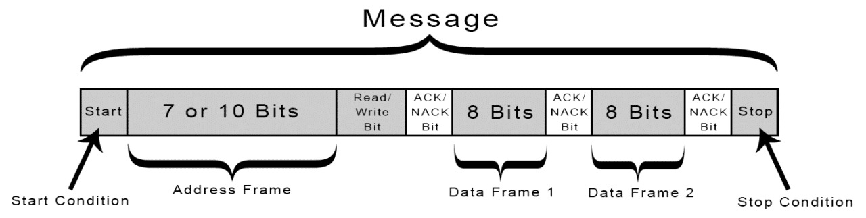
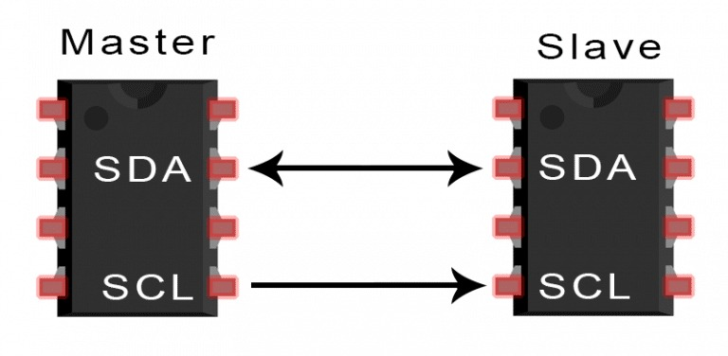
I2C Protocol
I2C combines the best features of SPI and UARTs.
With I2C, you can connect multiple slaves to a single master (like SPI) and you can have multiple masters controlling single, or multiple slaves.
I2C only uses two wires to transmit data between devices: SDA,SCL.
Source: https://www.circuitbasics.com/basics-of-the-i2c-communication-protocol/#google_vignette

Slide 11
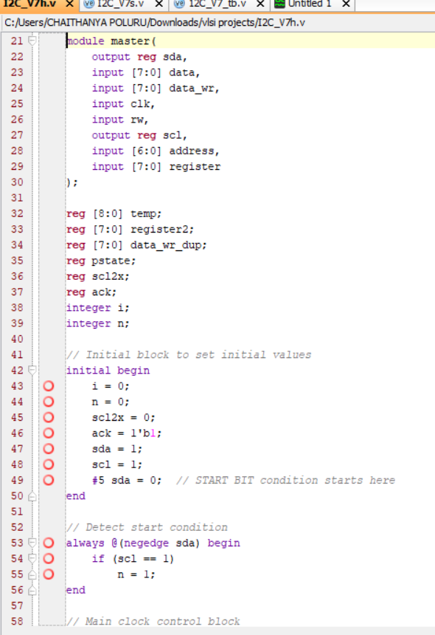
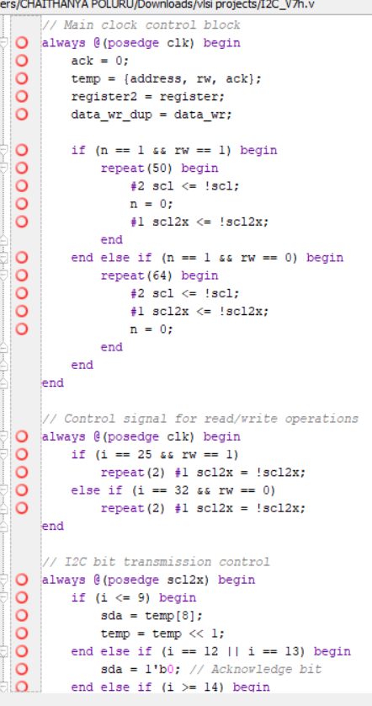
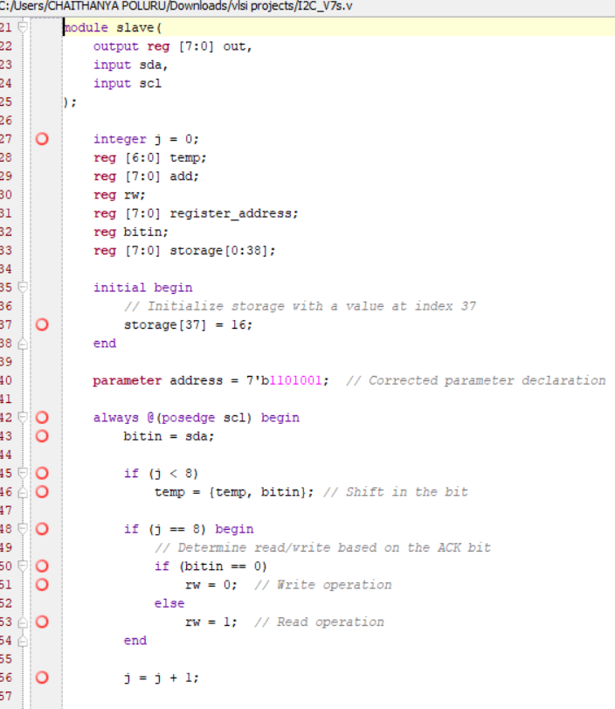
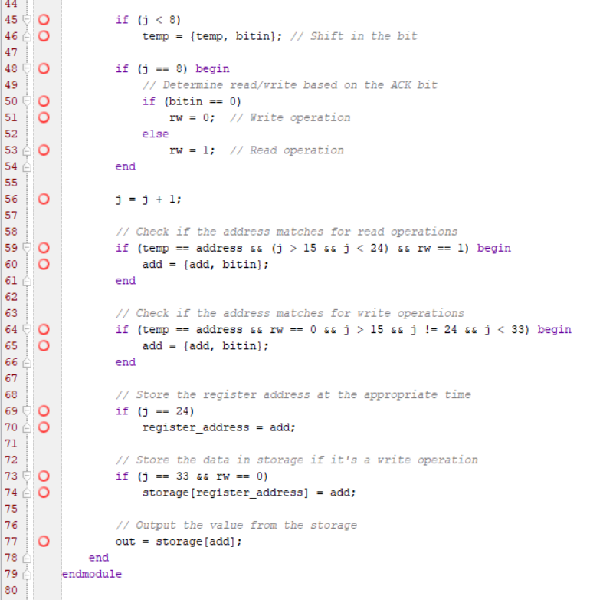
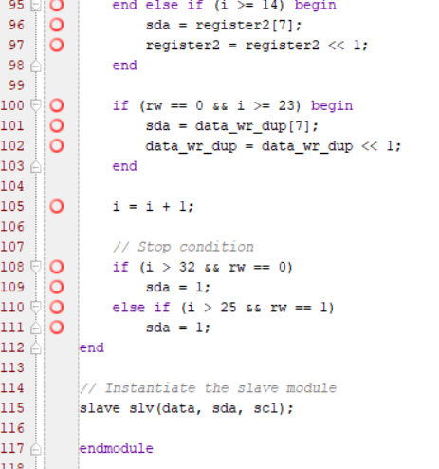
Codes & Testing
Master Code:
Slave Code

Slide 12
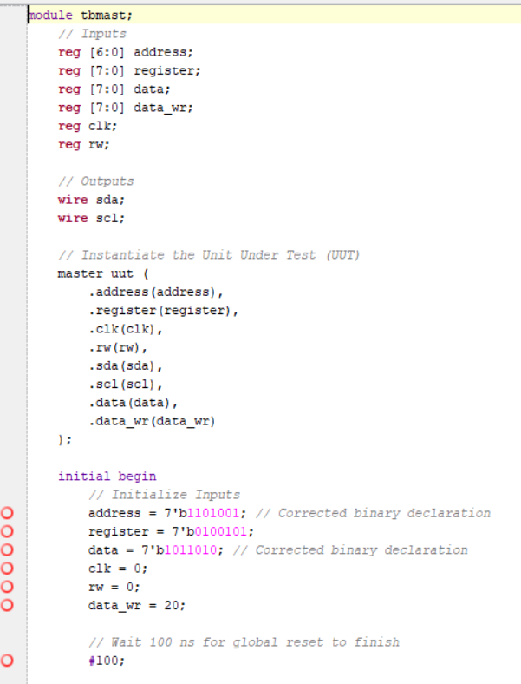
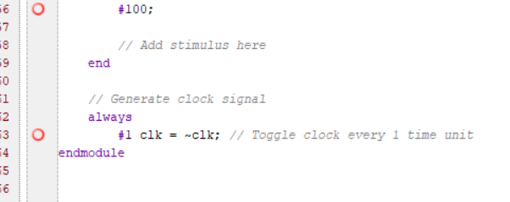
Testbench Code

Slide 13
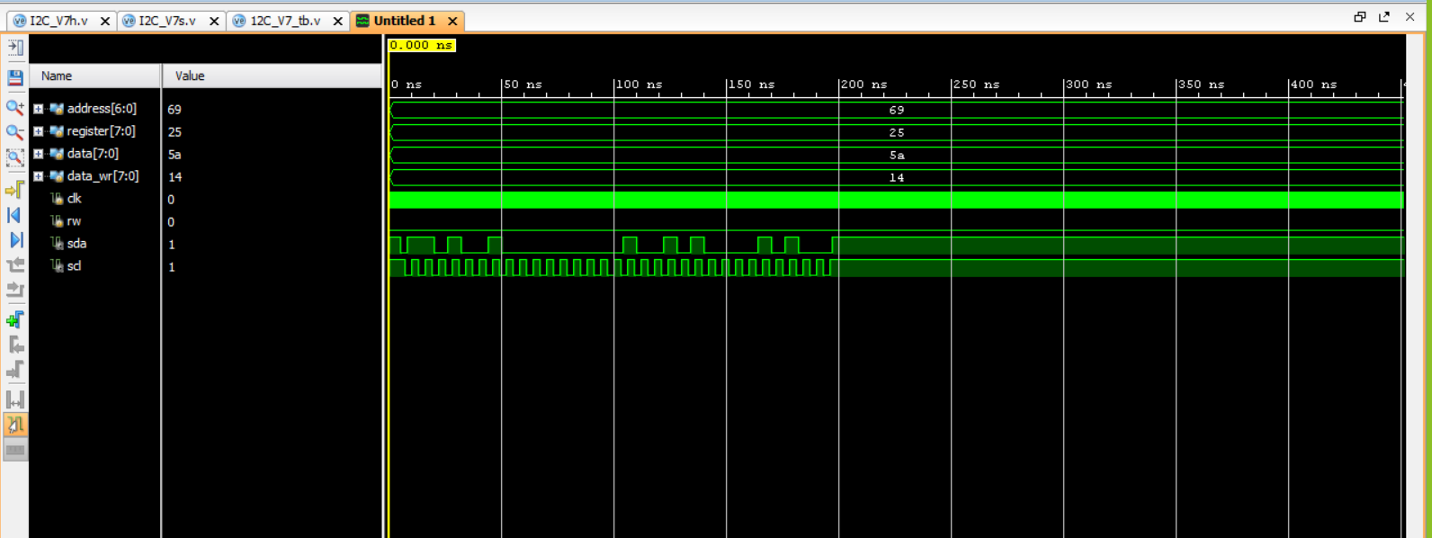
Implementation and Results
Results

Slide 14
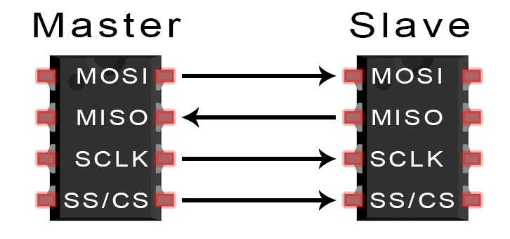
SPI Protocol
SPI is a common communication protocol used by many different devices. For example, SD card reader modules, RFID card reader modules.
One unique benefit of SPI is the fact that data can be transferred without interruption.
Any number of bits can be sent or received in a continuous stream.
Devices communicating via SPI are in a master-slave relationship.
The master is the controlling device (usually a microcontroller), while the slave (usually a sensor, display, or memory chip) takes instruction from the master.
The simplest configuration of SPI is a single master, single slave system, but one master can control more than one slave (more on this below).
Separate MISO and MOSI lines, so data can be sent and received at the same time.
Source : -https://www.circuitbasics.com/basics-of-the-spi-communication-protocol/

Slide 15
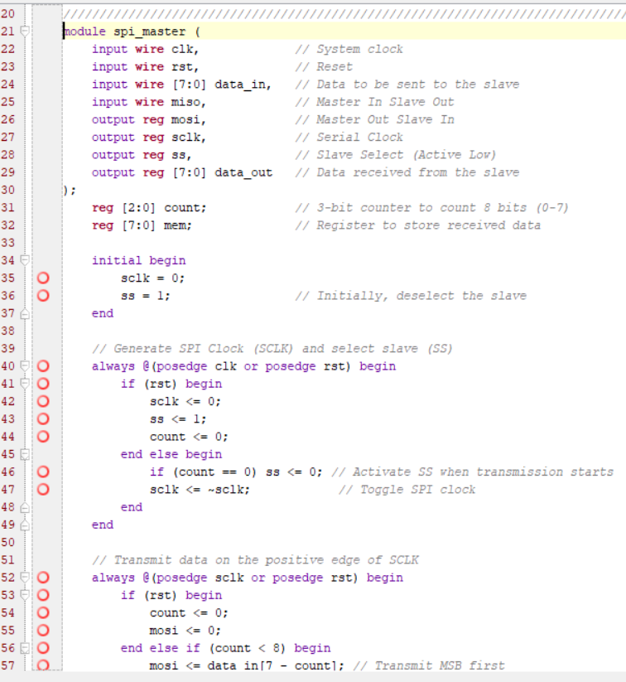
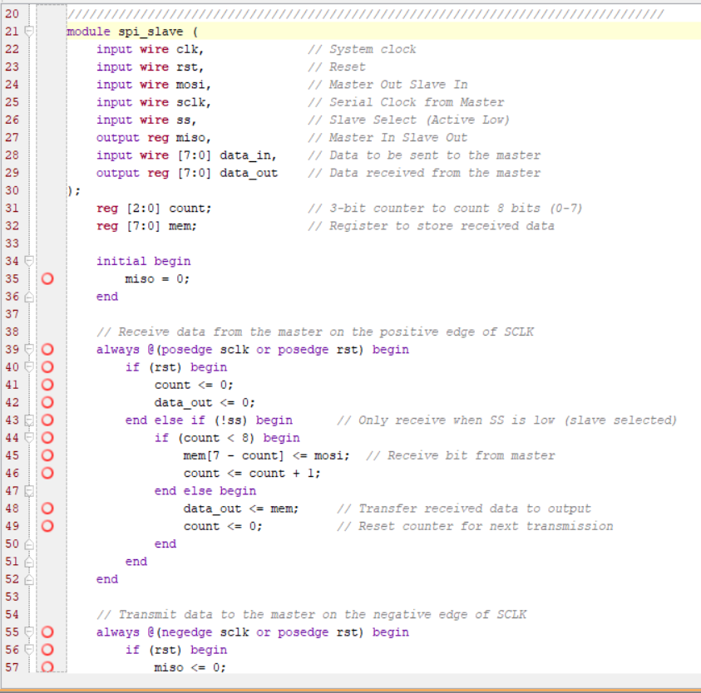
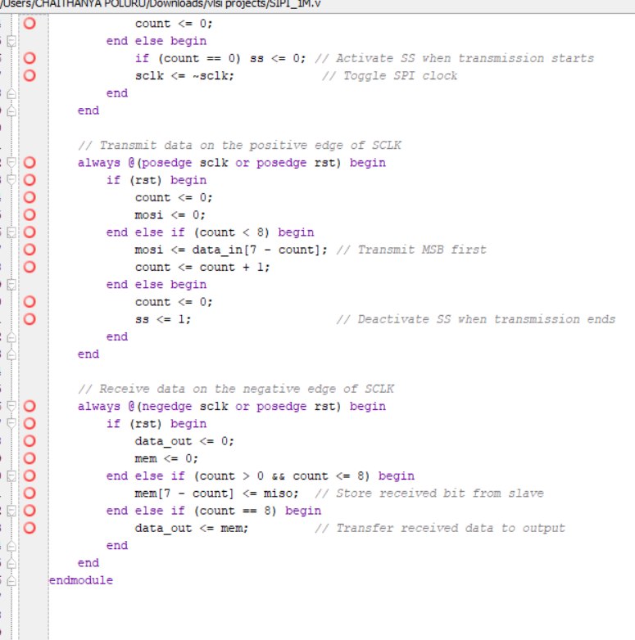
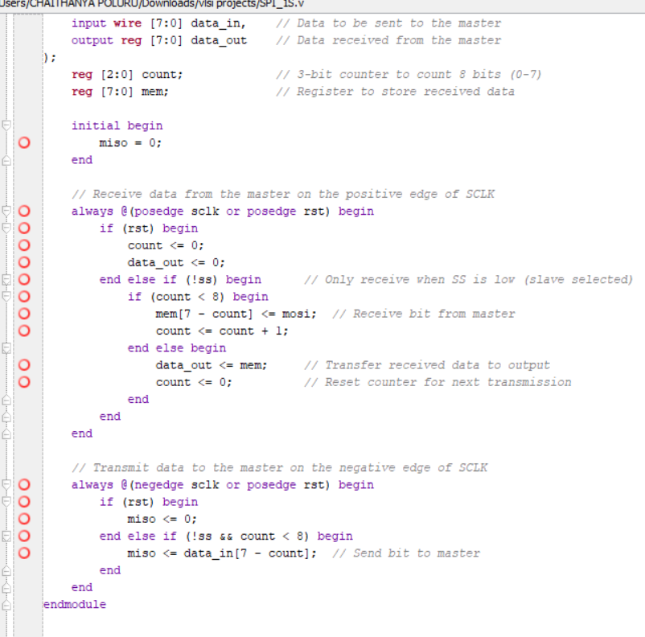
Codes
Master Code Slave Code

Slide 16
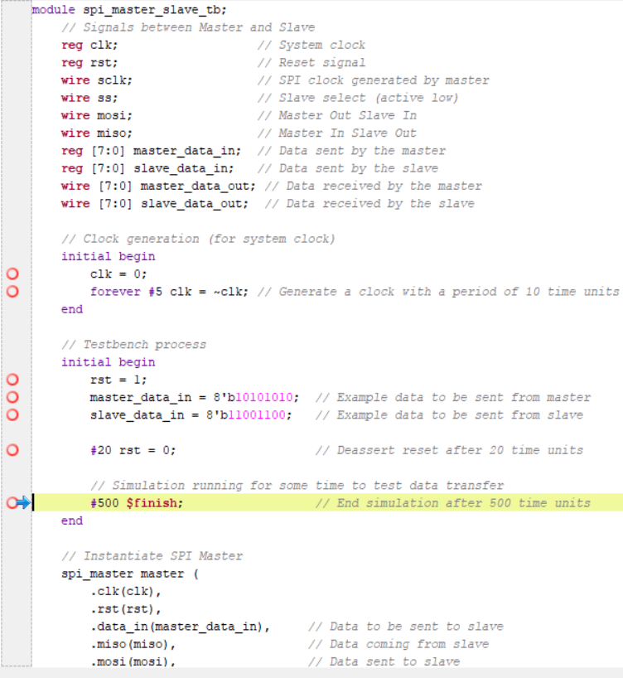
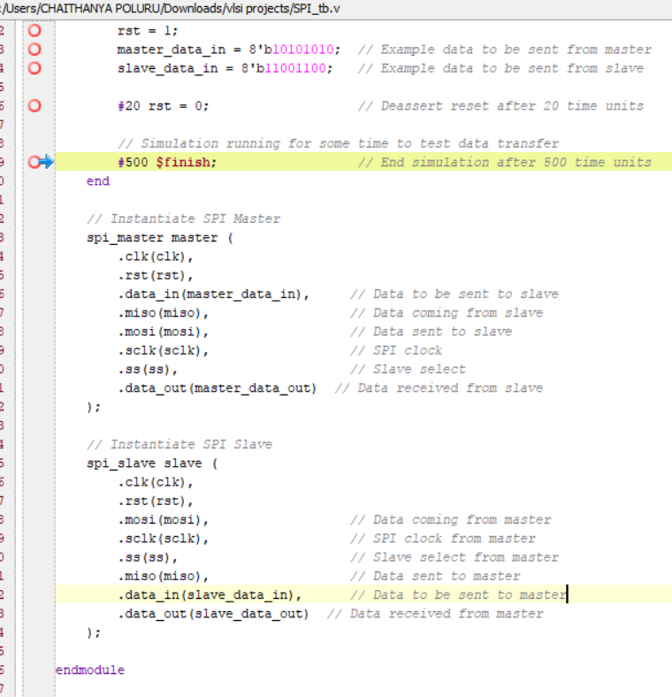
Testbench Code
Code:

Slide 17
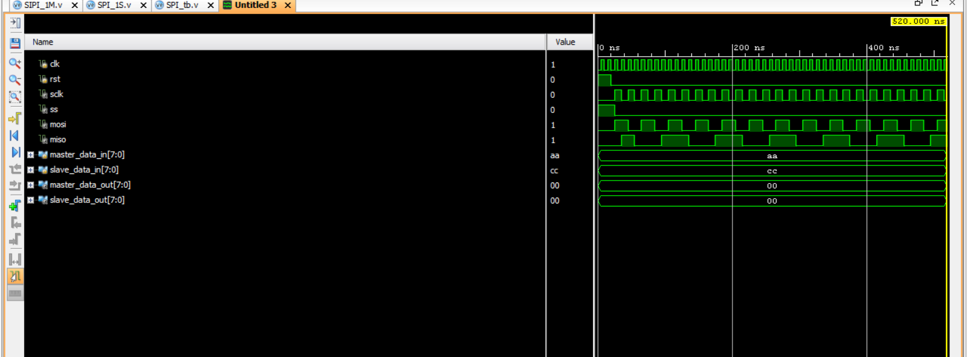
Implementation and Results
Result

Slide 18
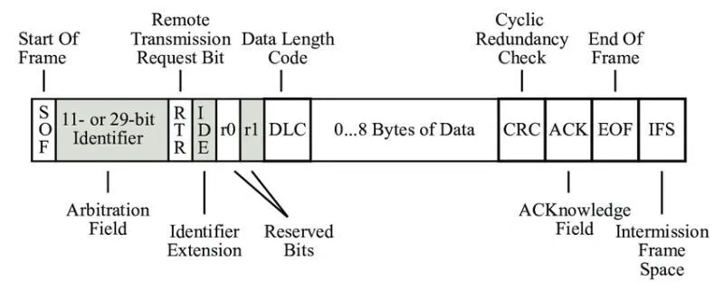
CAN Protocol
The Controller Area Network (CAN) protocol is a standardized method for communication between devices and microcontrollers.
It's a message-based protocol that uses a broadcast-type bus to allow different parts of a vehicle or machine to communicate with each other.
CAN is used in many industries, including automotive, industrial machinery, and medical devices.
Here are some basic facts about the CAN protocol:
Speed: CAN can facilitate data communication at speeds of up to 1 Mbit/sec.
Error detection: CAN has error detection capabilities, including Error Confinement, to enhance reliability.
Noise immunity: CAN is robustly immune to noise. Flexibility: CAN offers flexible data transmission.
Source : https://www.researchgate.net/figure/CAN-frame-format-based-on-Corrigan-2008_fig2_330202309

Slide 19
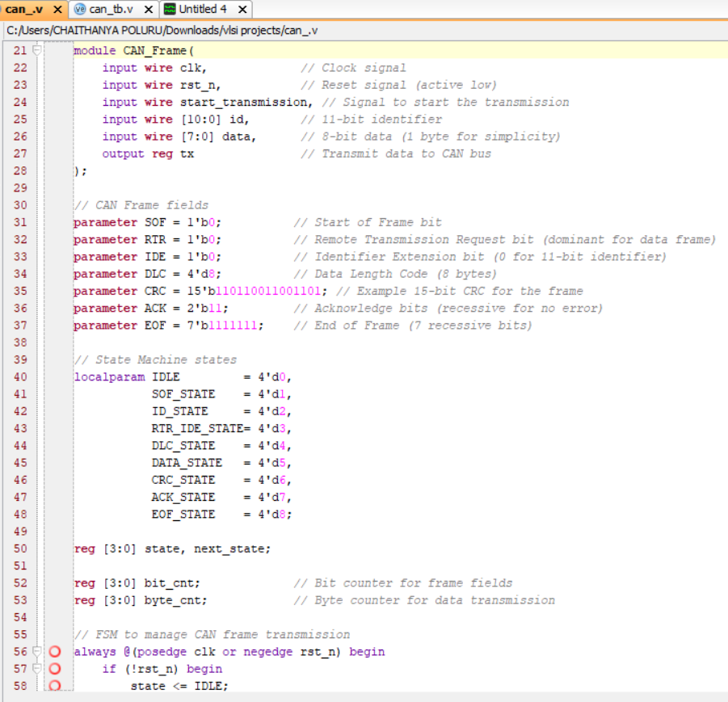
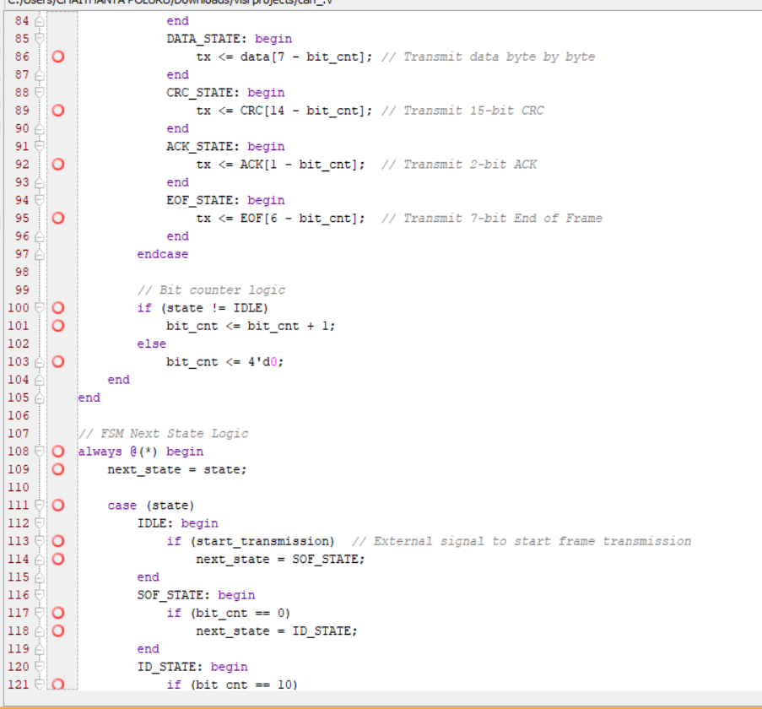
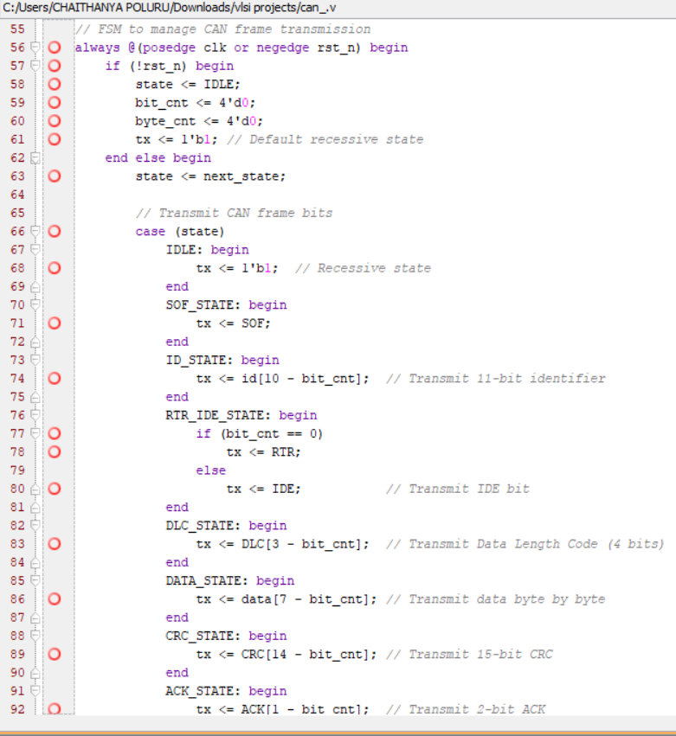
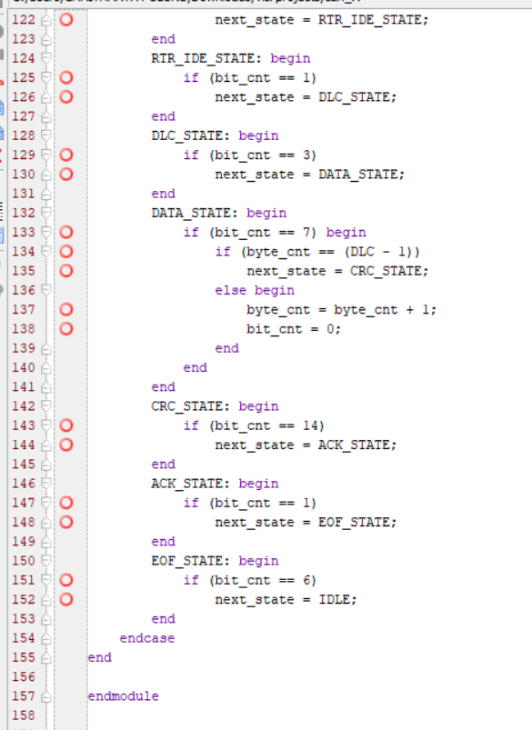
Codes
Code:

Slide 20
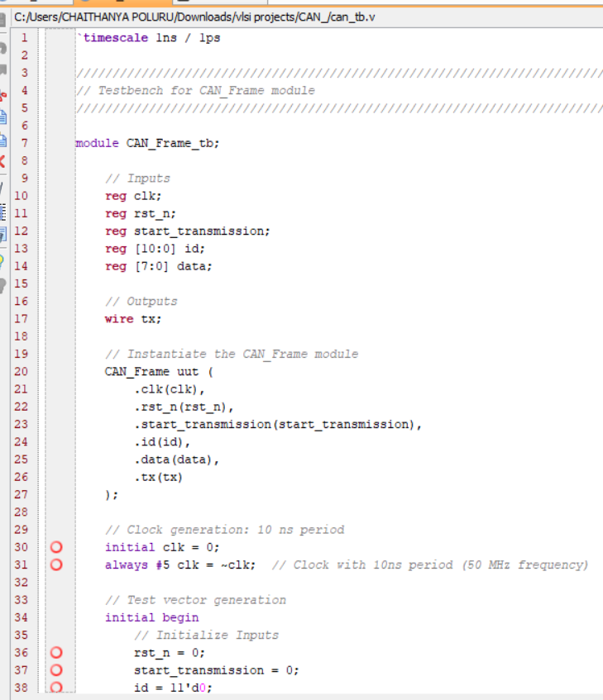
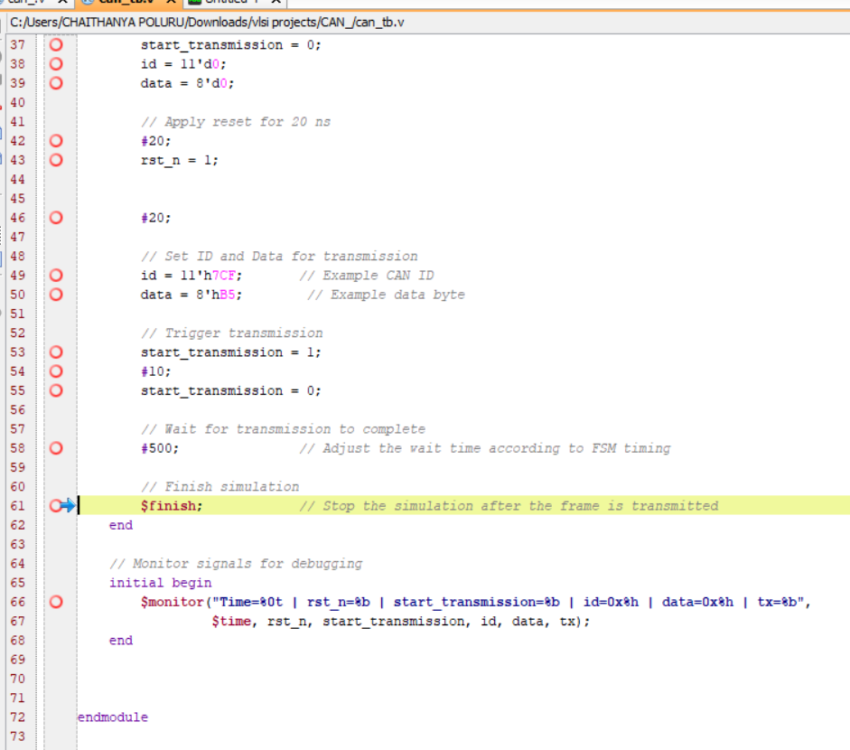
Testbench Codes
Code:

Slide 21
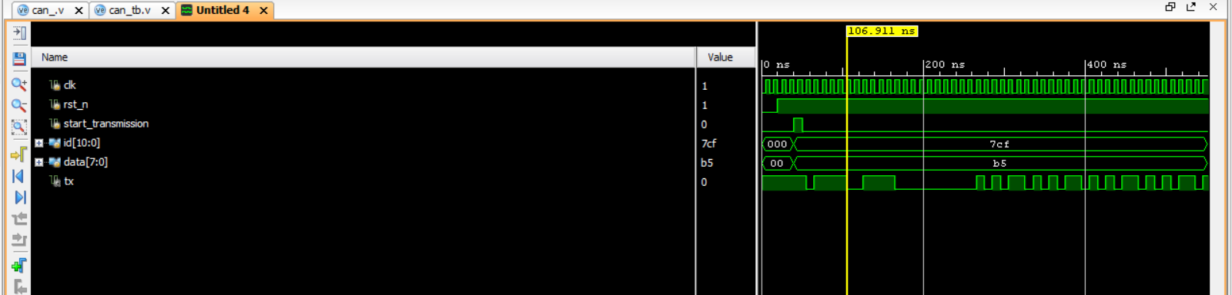
Implementation and Results)
Results:

Slide 22
Comparison of I2C ,SPI, CAN
S. No | Comparison | I2C | SPI | CAN
1. | Communication Method | Uses a two-wire interface (SDA for data, SCL for clock) for communication. | Utilizes a four-wire interface (MISO, MOSI, SCK, and SS) for full-duplex communication. | Uses a differential signaling method over a twisted pair cable, allowing for robust communication.
2. | Master/Slave Configuration | Supports multiple masters and multiple slaves, with addressable slaves. | Typically operates in a master/slave mode, where one master can control multiple slaves. | No strict master/slave arrangement; all nodes can transmit and receive messages, supporting multi-master configuration.
3. | Speed | 400 kHz – standard mode 1 MHz - fast mode | Generally, supports higher speeds than I2C, often exceeding 10 MHz, depending on the devices involved. | Operates at various speeds, commonly up to 1 Mbps, with options for lower speeds in certain applications.
4. | Data Integrity | Uses ACK/NACK bits for acknowledgment, which helps ensure data integrity during transmission. | Does not have built-in acknowledgment; relies on application-level protocols for error checking. | Incorporates built-in error detection and handling mechanisms, including CRC checks, to ensure reliable communication in noisy environments.

Slide 23
Contribution
Individual Contribution
Key contributions: Sunkara Venkatesh
Designed and implemented the I2C protocol in Verilog, focusing on signal transmission.
Focusing on timing constraints and data transfer between the master and multiple slave devices.
Contributed to the project GitHub repository by managing version control.
Key contributions: Poluru Sai Chaithanya
Implemented the SPI protocol in Verilog, ensuring accurate communication between master and multiple slave devices.
Performed SPI protocol simulations and analyzed the generated waveforms and took charge of designing the project poster and contributing to the final report.
Key contributions: Gurram Chethan Sree Royal
Designed and implemented the CAN protocol in Verilog, focusing on signal transmission and error detection mechanisms.
Led the simulation of CAN protocol and analyzed the output waveforms to ensure real-time communication and error handling, including thorough documentation and test cases.
Team Progress and Movement
Initial Progress: Researched the CAN, I2C and SPI protocols gathered specifications, and developed the initial Verilog design.
Mid-Progress: Completed the first set of simulations for the protocols, refining the code to ensure error detection works as expected. Integrated feedback from guide the team for improvements.
Final Progress: Finalized the protocols design and ensured successful simulation waveforms, prepared the GitHub repository for final submission, and contributed to the final report documentation and poster design.

Slide 24
Conclusion & Future Work
Summary and Conclusion
The project successfully implemented and simulated the CAN, I2C, and SPI communication protocols in Verilog, showcasing a understanding of embedded systems.
Each protocol was designed and rigorously tested to meet industry standards, focusing on signal integrity, timing accuracy, and reliable data transfer.
Extensive simulations and waveform analysis were conducted to verify the real-time performance and practical applicability of the protocols.
The project demonstrated the significance of communication protocols in key sectors like automotive, industrial, and consumer electronics.
Strong teamwork and individual contributions ensured the project’s success, laying a solid foundation for future work in hardware design and communication technologies.
Future Work
Hardware Implementation: The next phase of this project involves implementing the CAN, I2C, and SPI protocols on a Xilinx Virtex 7 and Zinq development kit. This will allow real-world testing and validation beyond simulations.
Real-Time Testing: By deploying the protocols on the Xilinx kit, we can evaluate their real-time performance in handling data transfers between connected devices such as sensors, memory units, and controllers.

Slide 25

THANK YOU

